Slide 1

Basketball Dribble Coach
CprE 575 Final Project
Matthew Orth

Slide 2

Background
Basketball is one of the most popular sports in the world
Dribbling is challenging and not much fun to practice
Basketball Dribble Coach:
Keep track of the number of completed reps
Keeps track of the number of times the player looks down while dribbling
Keeps track of the player’s position
Keeps track of the elapsed time during the drill

Slide 3
Audience and Need
Audience:
Young and experienced basketball players
People looking to improve their basketball dribbling skills
Need:
Coronavirus stay at home
People without access to gym or coach

Slide 4

Previous Approaches
Dribble Up
Tracks ball position and target dribble locations
Counts the number of completed reps
Assigns a grade for each drill
Has social and connectivity capabilities
Subscription-based
Uses special type of ball

Slide 5



Equipment and Technologies
Equipment:
Computer with webcam
Standard orange basketball
Environment with space
Technologies:
OpenCV
Qt
C++

Slide 6
Algorithms and Data Structures
Background subtraction
Morphology
Color filter tracking
Contour detection
Haar Cascade Classifier
Contour intersection detection
Data to store app info

Slide 7
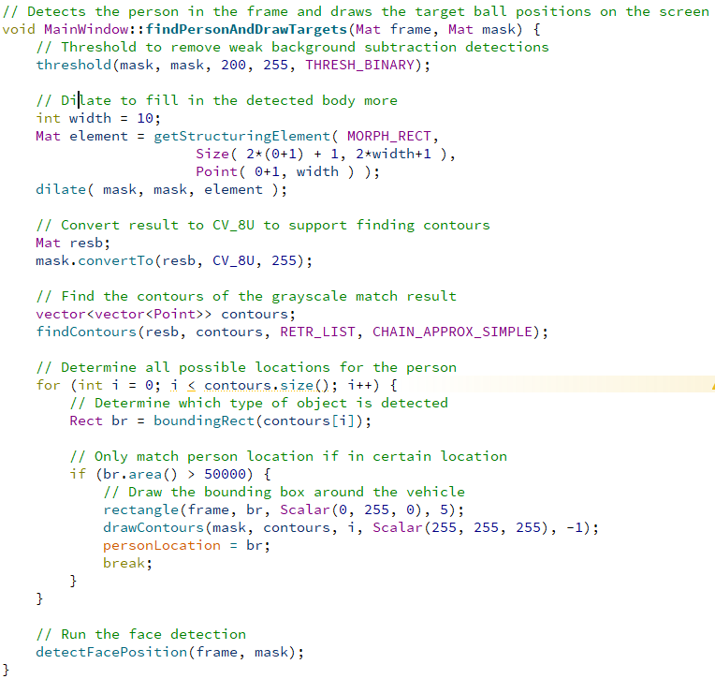
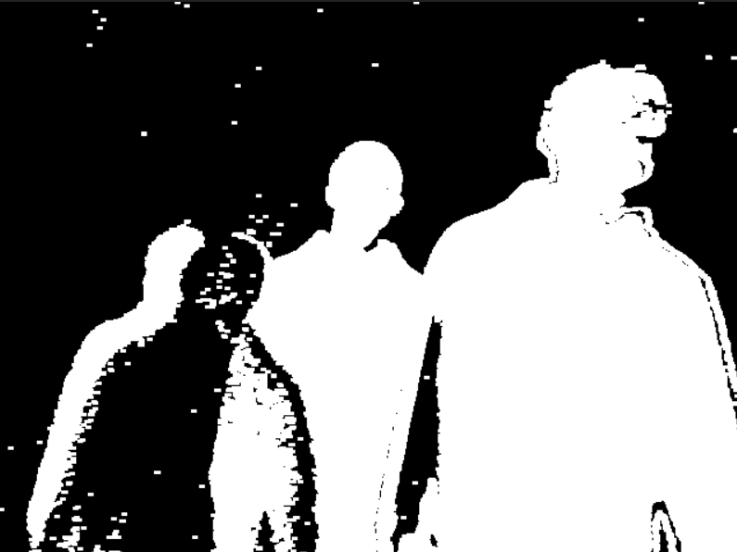
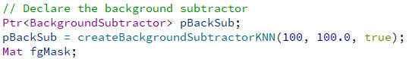
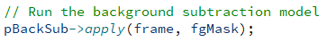
Person Detection

Slide 8
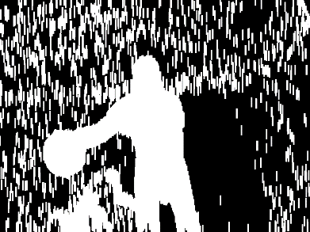
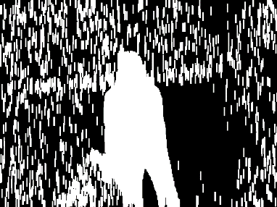
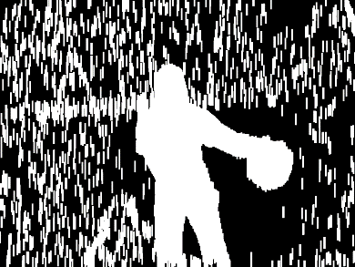
Person Detection

Slide 9
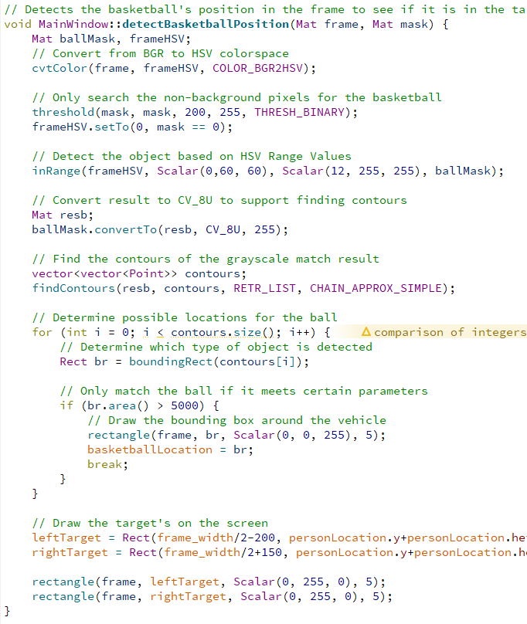

Basketball Detection

Slide 10
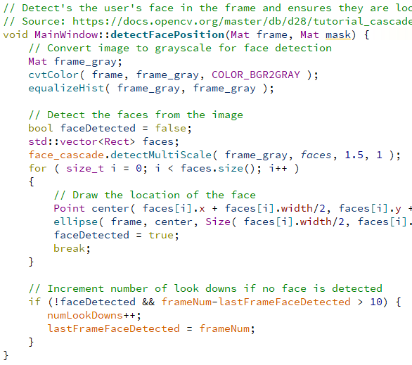

Face Detection

Slide 11
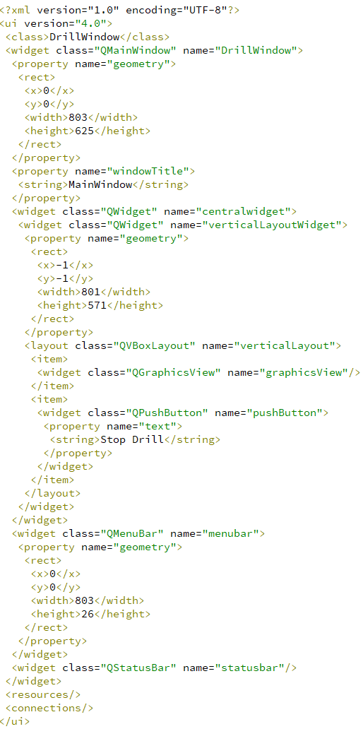
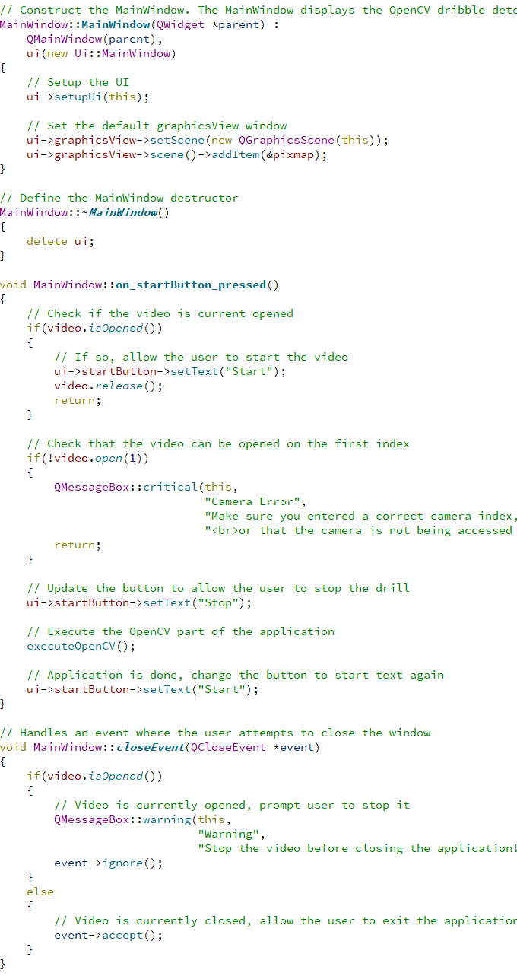
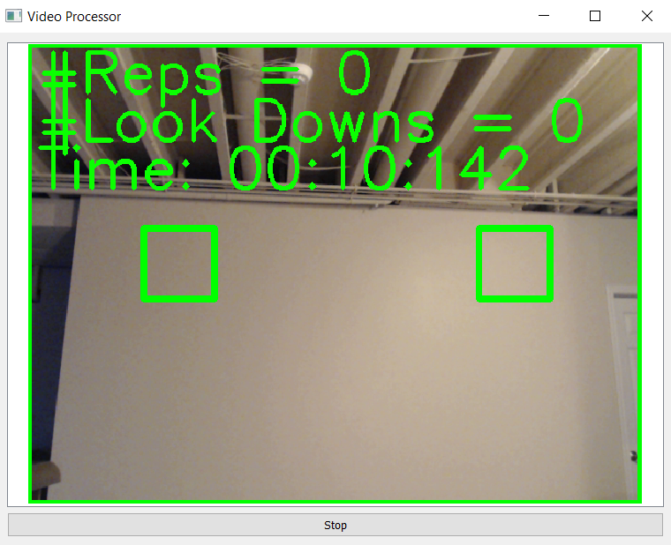
Qt Application

Slide 12
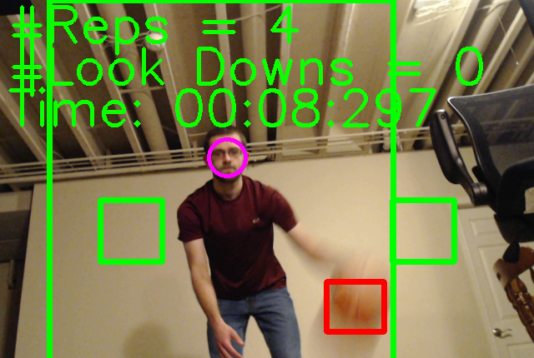
Overall Results

Slide 13
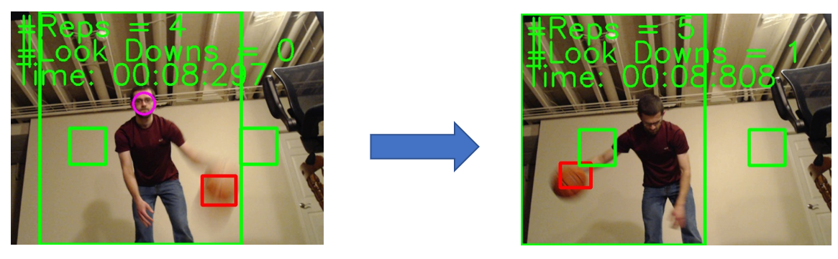
Rep and Look Down Counting

Slide 14
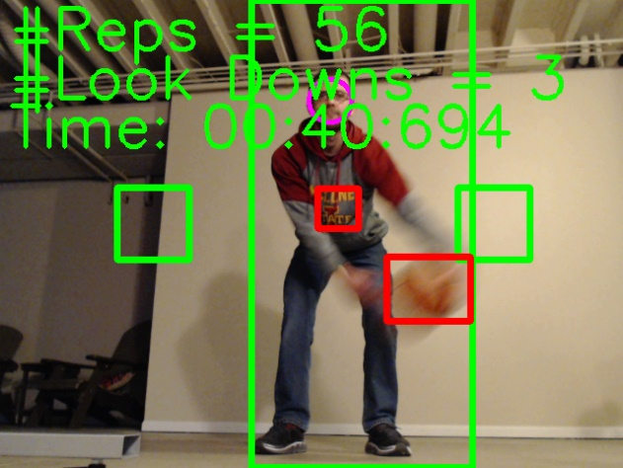
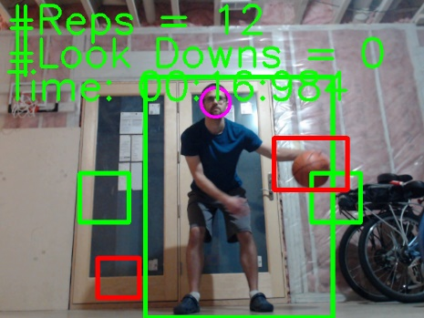
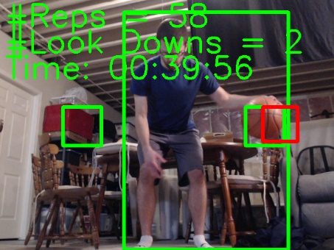
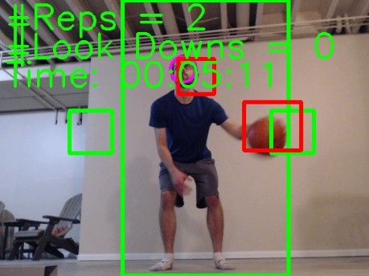
Different Clothing, Backgrounds, and Lighting

Slide 15
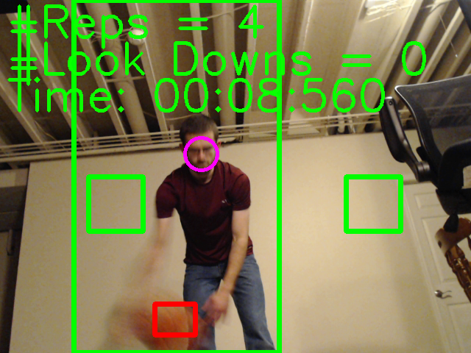
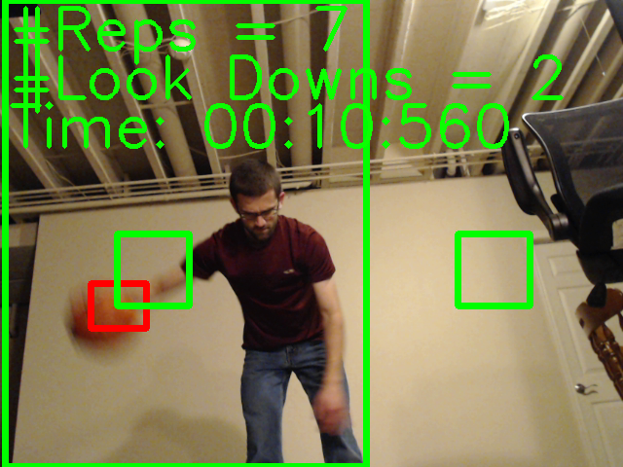
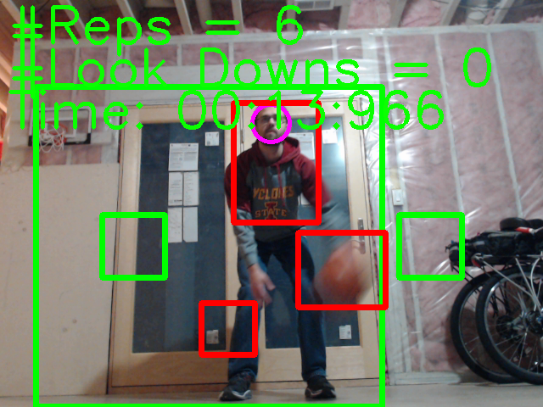
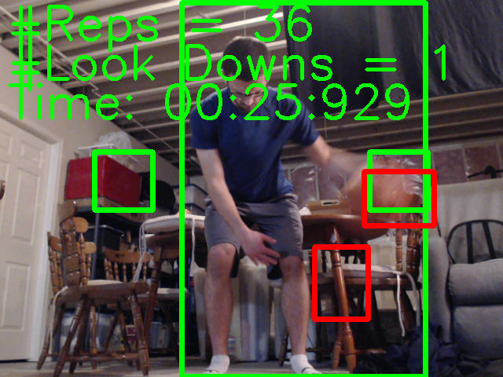
Challenges and Limitations
Similar colors to basketball
Accurate face detection

Slide 16
Evaluation Results
Environment | Correct Repetition % | Correct Look Down %
Simple Backdrop – Jeans & Sweatshirt | 100% | 75%
Simple Backdrop – Shorts & T-shirt | 87% | 75%
Busy Backdrop – Jeans & Sweatshirt | 96% | 100%
Busy Backdrop - Shorts & T-shirt | 93% | 75%
Window Backdrop – Jeans & Sweatshirt | 83.5% | 33.3%
Window Backdrop – Shorts & T-shirt | 89.5% | 66.7%
Total | 91.5% | 70.8%

Slide 17
Improvements and Lessons Learned
Improvements:
More integrated user experience
Focus on more of the application aspects of the project
Improve basketball and face detection
Lessons Learned:
Real-time computer vision
Application of computer vision methodologies

Slide 18
